Slide 1


Data Science in Context
Explainable AI (XAI)

Slide 2
What is Explainable AI?
Explainable AI (XAI):
refers to the methods, techniques, or set of processes that allows human users to comprehend and trust the results and output created by machine learning algorithms
Key Concepts
Provides the capacity to express why an AI system reached a particular decision, recommendation, or prediction
Focuses on the norms that society expects AI systems to follow
One of several properties that characterize trust in AI systems
Differences from AI
Contrasts the concept of the “black box” in machine learning
Engineers or data scientists who create the algorithm can NOT understand or explain what exactly is happening inside them or how the AI algorithm arrived at a specific result

Slide 3



XAI Concept
TODAY
Task
Why that output?
Why not something else?
When can output be trusted?
Training Data
Machine Learning Process
Learned Function
Decision or Recommendation
User
XAI
Task
Training Data
New Machine Learning Process
Explainable Model
Explanation Interface
Understands why
Understands why not
Knows when to trust the output
User

Slide 4
XAI Relevance
AI Sophistication
Explainability is Becoming Significantly More Challenging
The more sophisticated an AI system becomes, the harder it is to explain derived insights
Today AI application modeling techniques, are inherently more difficult for humans to understand
Ex: Deep learning, Neural networks
Bias has been a long-standing risk in training AI models
Ex: race, gender, age or location
AI Explainability
Need for XAI
The nature of some AI systems contribute to decisions that impact a person’s life
Legal demand grows for transparency
Desire to create trustworthy AI
Crucial to build trust and confidence when putting AI models into production
One of the key requirements for implementing Responsible AI (RAI)
Potential Outcomes of Not Adopting XAI
Suspicions that the system is biased or unfair can raise concerns about harm to individuals and to society
May slow societal acceptance and adoption of the technology
Failure to articulate the rationale can affect the level of trust users will grant that system
Notes:
Advanced machine learning engines often remain a black box
Need
Drive to accompany AI outputs with explanations due to the nature of some AI systems contributing to decisions that impact a person’s life
Ex: medical diagnoses, loan applications, recommend jail sentences
Laws and regulations that require decisions from automated systems to provide info about the reasoning behind those decisions

Slide 5
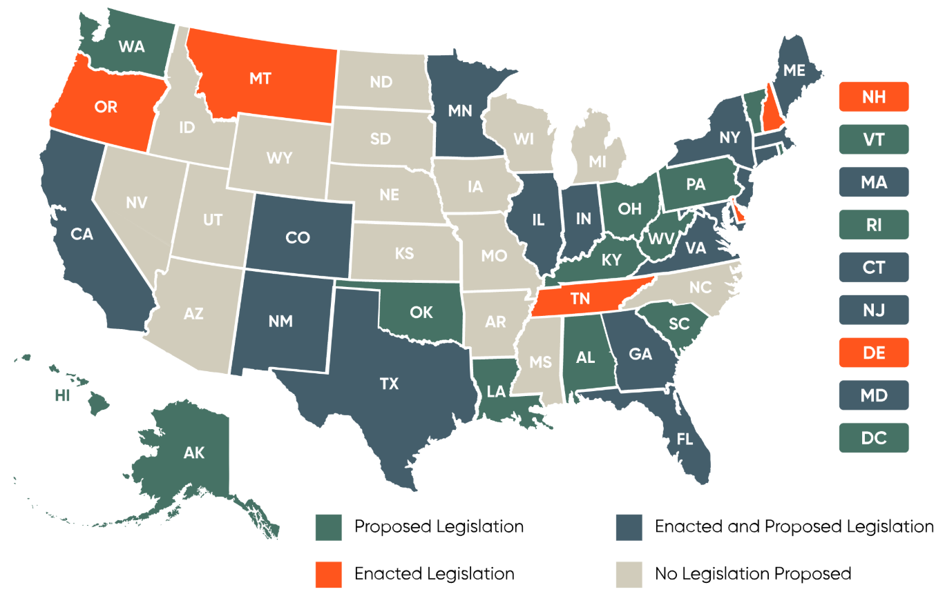
US State-by-State AI Legislation Snapshot

Slide 6
4 Principles of XAI
For a system to be explainable, it must provide an explanation
Explanation:
Characterization needs to be human-centered
Explanation Quality Metrics
Fundamental Properties of the Explanation
Meaningful:
Understandable to people
Explanation Accuracy:
Correctly reflect the system’s process for generating the output
Knowledge Limits:
Indicates when operating outside its designed conditions
Notes:
Explanation:
A system delivers or contains accompanying evidence or reason(s) for outputs and/or processes
Meaningful:
A system provides explanations that are understandable to the intended consumer(s)
Explanation Accuracy:
An explanation correctly reflects the reason for generating the output and/or accurately reflects the system’s process
Knowledge Limits:
A system only operates under conditions for which it was designed and when it reaches sufficient confidence in its output

Slide 7
4 Principles of XAI: Explanation
Explanation:
A system delivers or contains accompanying evidence or reason(s) for outputs and/or processes
Supplies evidence, support, or reasoning related to an AI outcome
Independent of whether the explanation is correct, informative, or intelligible
Does not impose any metric of quality
Explanations will, and should, vary, according to the given system and scenario
Large range of ways an explanation can be executed or embedded into a system

Slide 8

4 Principles of XAI: Meaningful
Meaningful:
Understandable to people
A system fulfills the Meaningful principle if the intended recipient understands the system’s explanation(s)
Challenge – What is a “Good” Explanation?
Developing measurement protocols that adapt to different audiences
Many factors contribute to what an individual will consider a “good” explanation
Different groups of people will also have different desires from a system’s explanations
Different scenarios and needs will drive what is important and useful in a given context
What an individual considers meaningful will change over time
Solution
Understanding the audience’s needs, level of expertise, and relevancy to the question at hand
Scoping these factors will bound the possibilities for how to execute the explanation in a goal-oriented and meaningful way
Notes:
Determining the criteria for a ”good” explanation is an active debate in various fields
(e.g., Cognitive science, computer science, psychology, and philosophy)
developers and designers may have very different explanation needs than policy makers and end users

Slide 9
4 Principles of XAI: Explanation Accuracy
Explanation Accuracy:
Correctly reflect the system’s process for generating the output
Imposes veracity on a system’s explanations
Describes how the system came to its conclusion or action
Distinct from decision accuracy (whether the system’s judgment is correct or incorrect)
Needs to account for the level of detail in the explanation
Consideration – Level of Detail
Similar to how humans approach explaining complex topic
Detailed Explanation extensive and technical detail | Simple Explanation critical point(s) or high-level reasoning
Accurately reflects the system’s processing | Highly understandable
Sacrifices usefulness and accessibility to certain audiences | Does not fully characterize the system
Highlights how explanation accuracy and meaningfulness interact
Together, the principles only call for a system to produce explanations that are intelligible to the intended audience

Slide 10


4 Principles of XAI: Knowledge Limits
Knowledge Limits:
Indicates when operating outside its designed conditions
Identifies cases that were not designed or approved to operate, or in which answers are not reliable
Safeguards answers
Ensures judgment is not provided when it may be inappropriate to do so
Increases trust in system
Prevents misleading, dangerous, or unjust outputs
Two Ways System Can Reach or Exceed Knowledge Limits
Outside Domain
Low Confidence (internal threshold)
Example System: classifies birds
Example System: classifies birds
User Input:
outside scope
System Output:
Answer: could not find any birds in the input image
Explanation: the system cannot provide an answer
User Input:
low quality
System Output:
Answer: bird found in the input image, but the image quality is too low to identify it
Explanation: the system cannot provide an answer

Slide 11
Citations
Ibm. (2024a, December 19). What is explainable AI (XAI)?. IBM. https://www.ibm.com/think/topics/explainable-ai#:~:text=Explainable%20artificial%20intelligence%20(XAI)%20is,expected%20impact%20and%20potential%20biases.
Phillips, P. J., Hahn, C. A., Przybocki, M. A., Fontana, P. C., Yates, A. N., Kristen, & Broniatowski, D. A. (2021, September). Four principles of Explainable Artificial Intelligence. https://nvlpubs.nist.gov/nistpubs/ir/2021/NIST.IR.8312.pdf
US state-by-state AI legislation snapshot. BCLP. (2024, June 7). https://www.bclplaw.com/en-US/events-insights-news/us-state-by-state-artificial-intelligence-legislation-snapshot.html

